Slide 1
Multiple Regression Model of Wine Quality
Data Mining II

Slide 2
Data
Dataset:
Wine Quality – white wine
Attributes:
Fixed acidity | Total sulfur dioxide
Volatile acidity | Density
Citric acid | pH
Residual sugar | Sulphates
Free sulfur dioxide | Alcohol
Chlorides | Quality
Link:
http://archive.ics.uci.edu/ml/datasets/Wine+Quality
Citation:
P. Cortez, A. Cerdeira, F. Almeida, T. Matos and J. Reis.
Modeling wine preferences by data mining from physicochemical properties.
In Decision Support Systems, Elsevier, 47(4):547-553, 2009.
Data Mining II

Slide 3
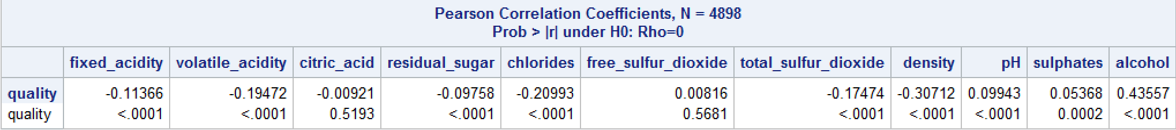
Correlation Coefficients
Weak linear correlation
Data Mining II

Slide 4
Test of Normality
 | Kolmogorov-Smirnov D | p value
Fixed acidity | 0.066232 | <0.0100
Volatile acidity | 0.104513 | <0.0100
Citric acid | 0.11275 | <0.0100
Residual sugar | 0.136624 | <0.0100
Chlorides | 0.207263 | <0.0100
Free sulfur dioxide | 0.057682 | <0.0100
Total sulfur dioxide | 0.04465 | <0.0100
Density | 0.05221 | <0.0100
pH | 0.049269 | <0.0100
Sulphates | 0.08685 | <0.0100
Alcohol | 0.091573 | <0.0100
Data Mining II

Slide 5
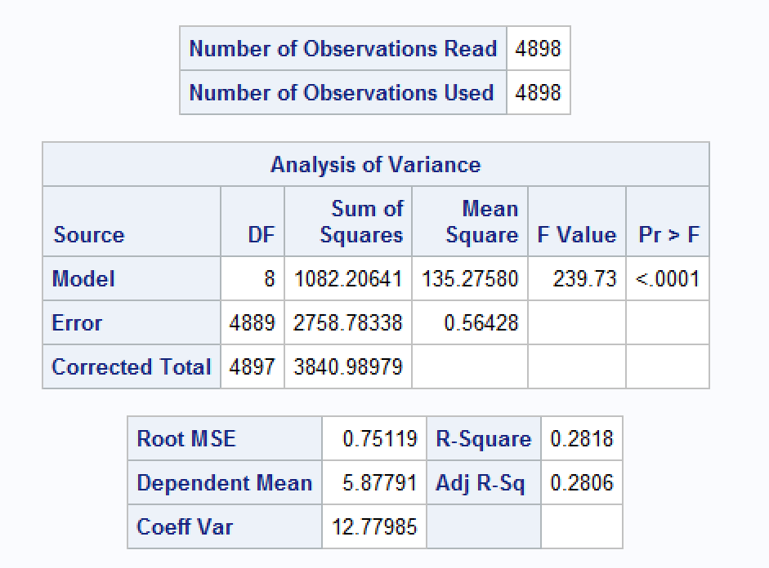
Multiple Regression (Stepwise)
F Value: 239.73
Adj R²: 0.2806
Data Mining II

Slide 6
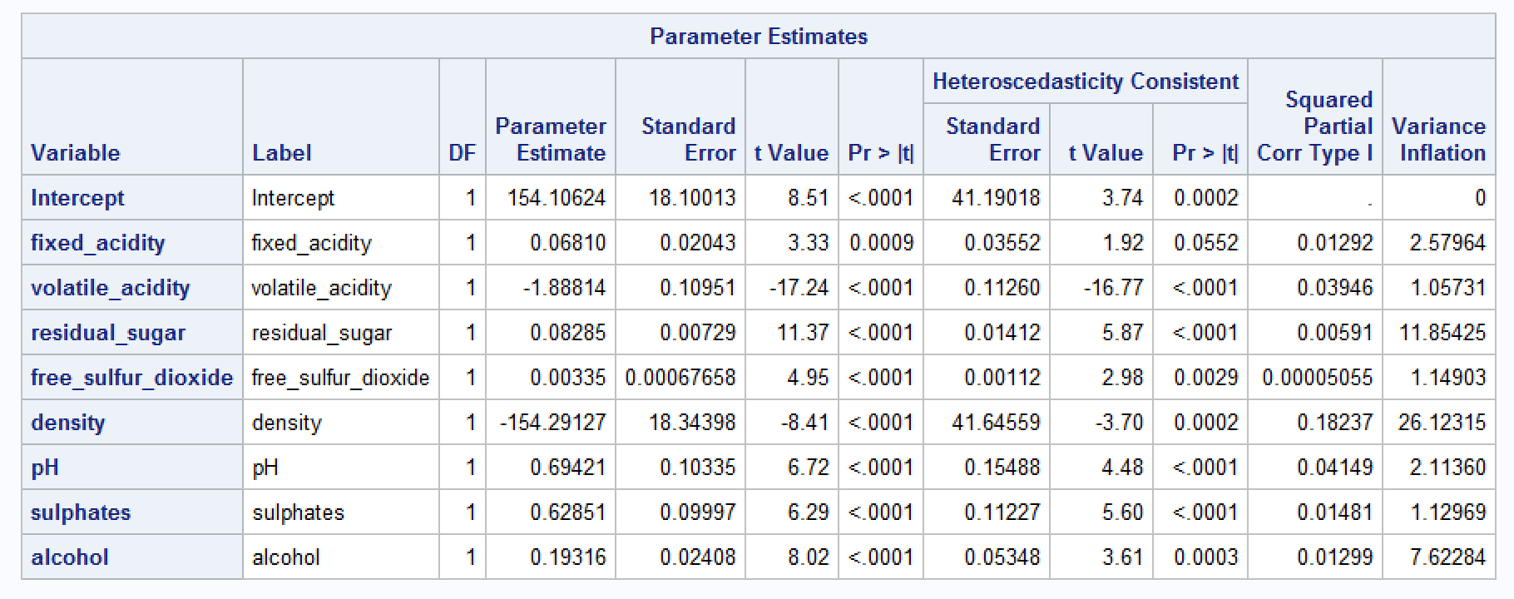
Parameter of Multiple Regression
Highly correlated
Data Mining II

Slide 7
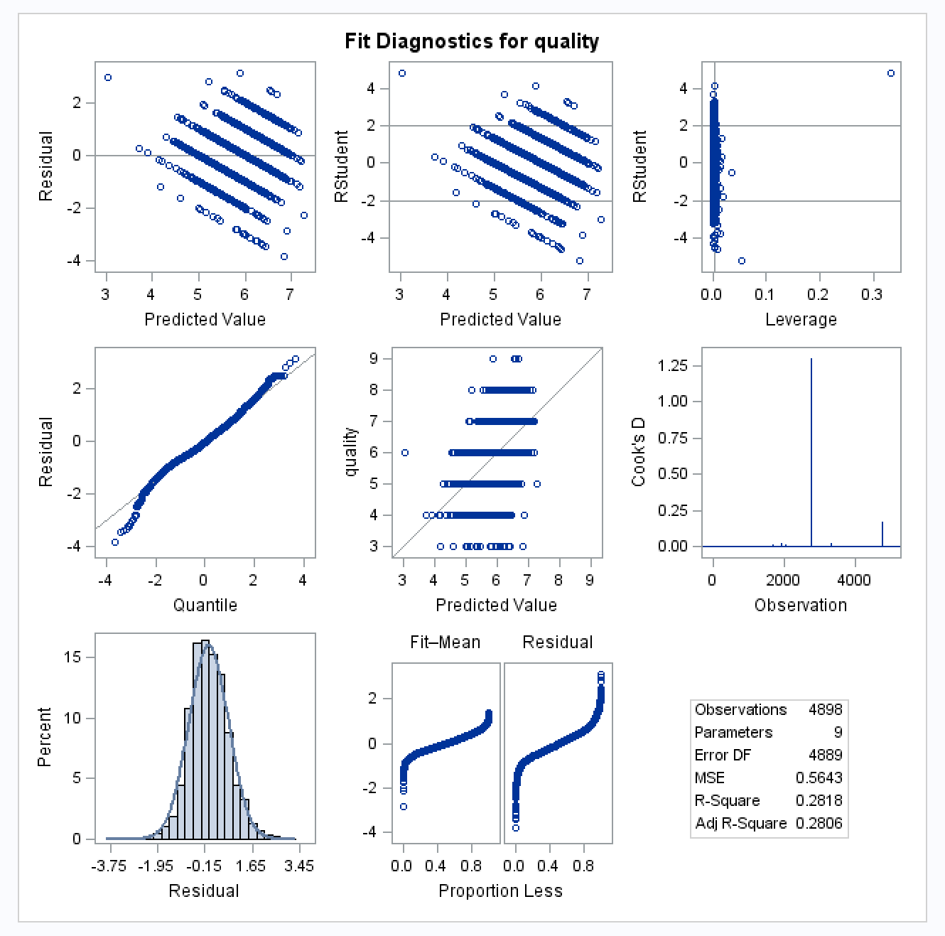
Residual
Might be high
influential point
Acceptable
normality
Data Mining II

Slide 8
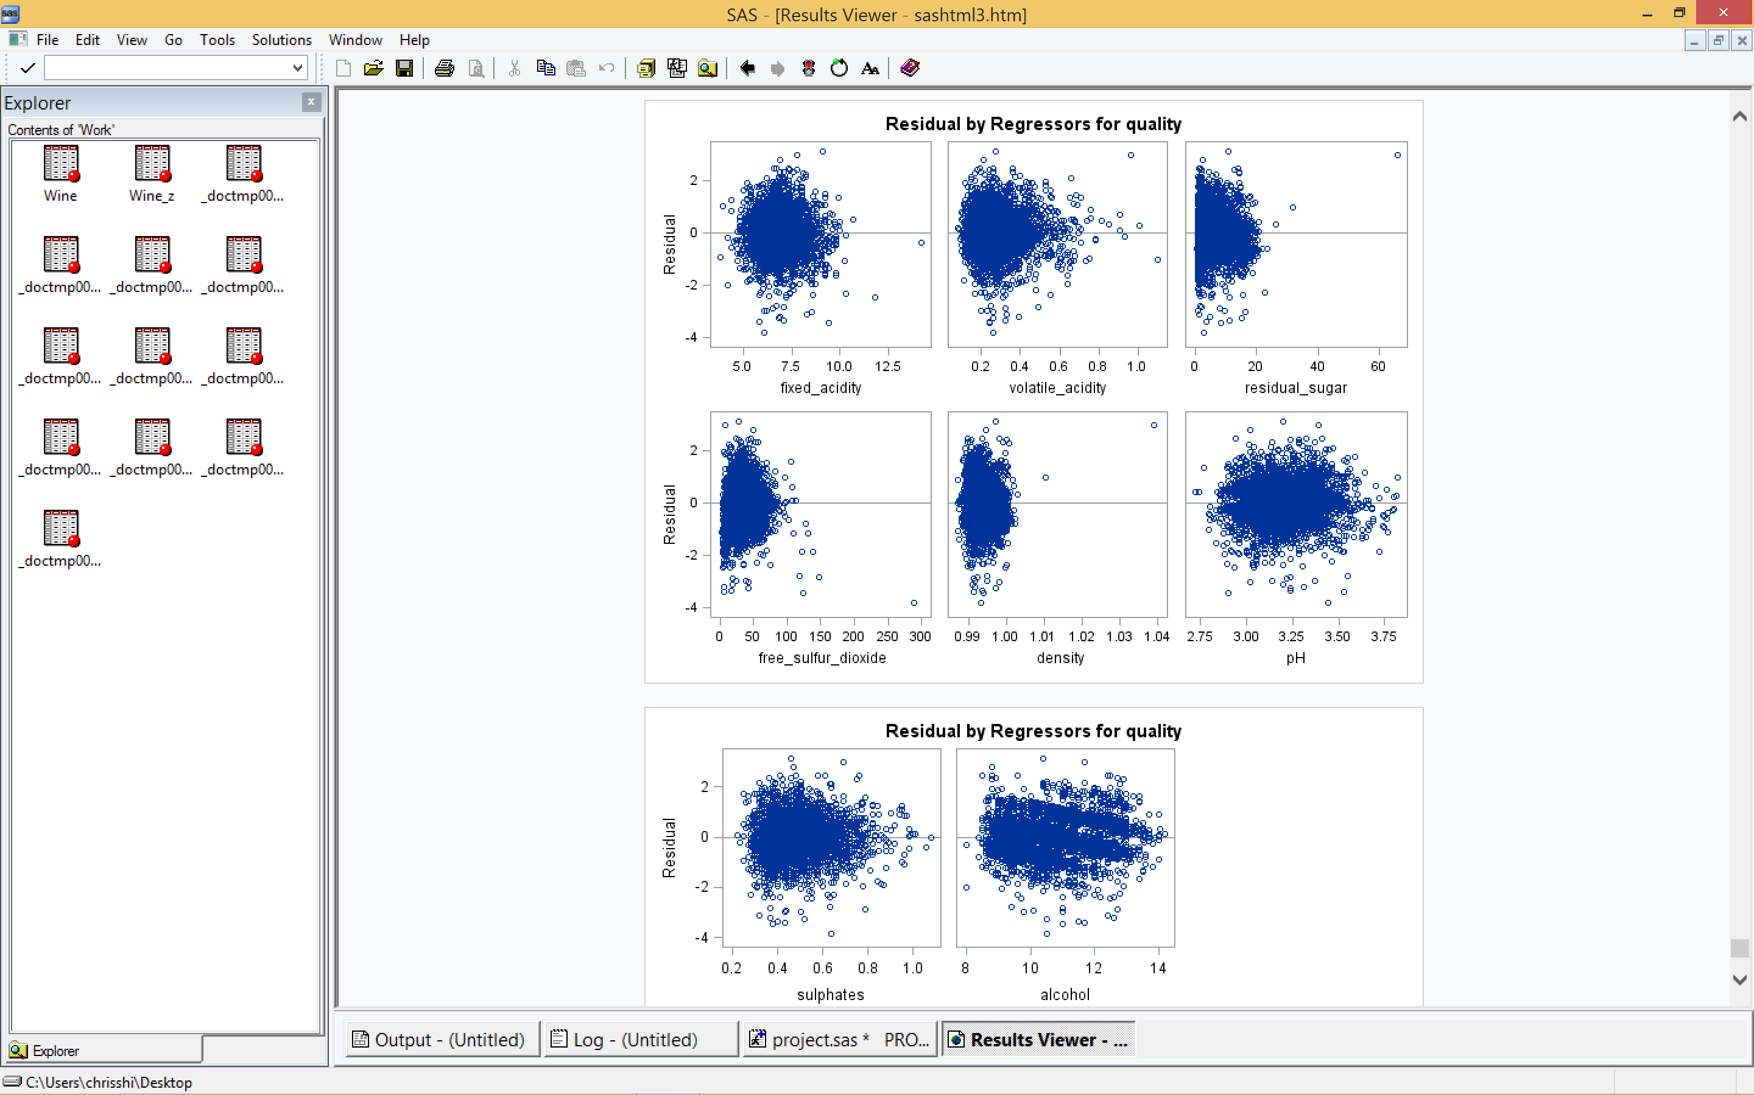
Residual
Outliers
Data Mining II

Slide 9
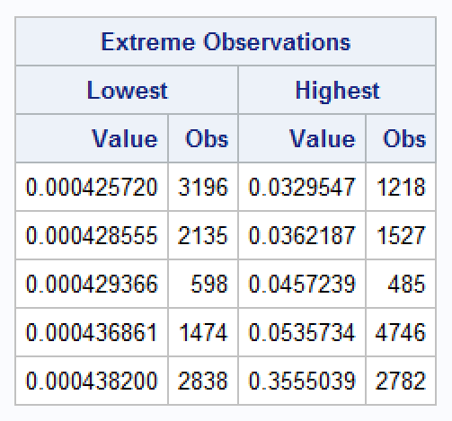
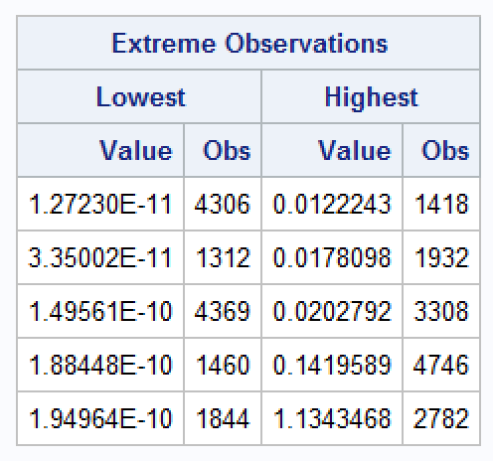
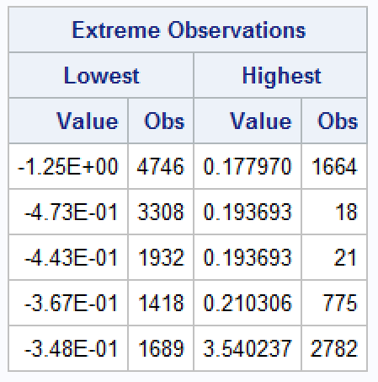
Find High influential point
Leverage
Cook’D
Dffits
Observation #2782 is a high influential point
Remove #2782
Data Mining II

Slide 10
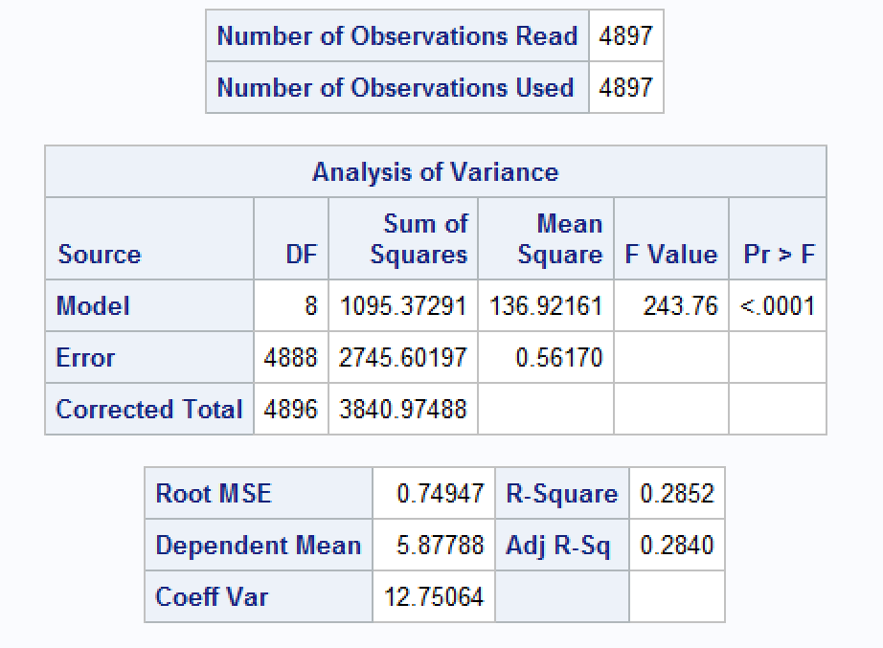
Compare models after removing #2782
New:
Original:
With higher F value and Adj. R²
Better!
Data Mining II

Slide 11
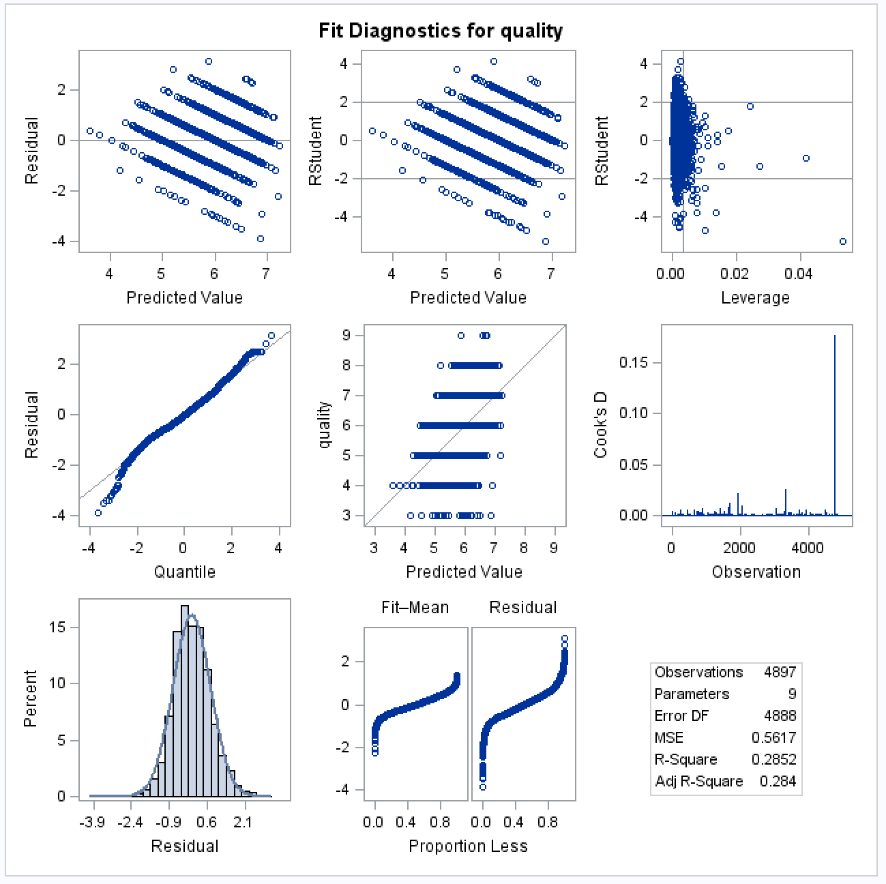
Residual of new model
Might be high
influential point
Data Mining II

Slide 12
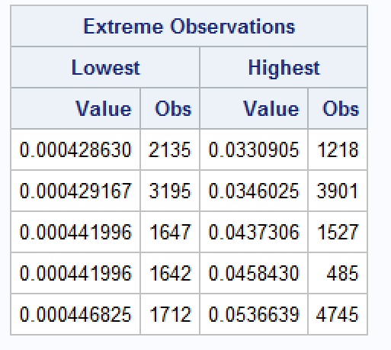
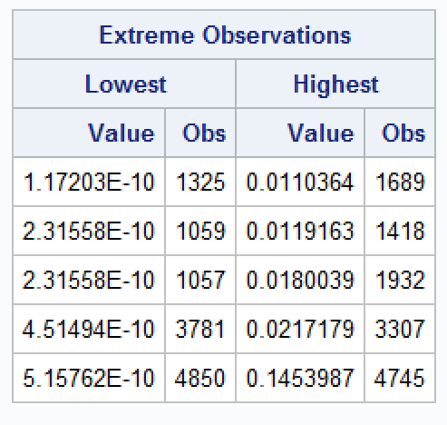
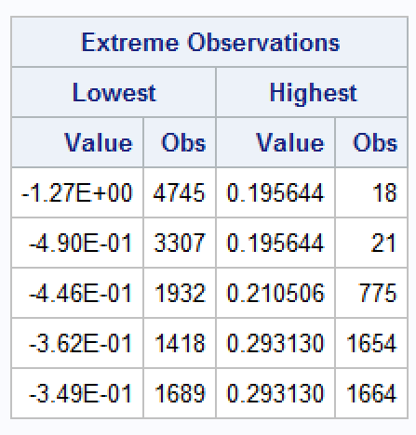
Check influential point again
Leverage
Cook’D
Dffits
No significant influence
Data Mining II

Slide 13
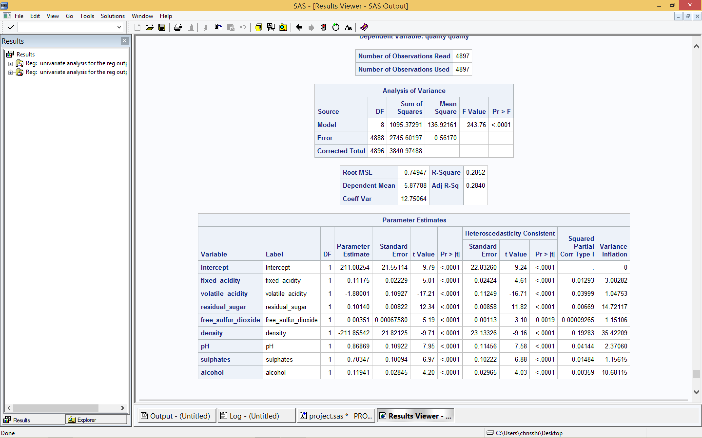
Multicollinearity
Highly correlated
Remove Density
Data Mining II

Slide 14
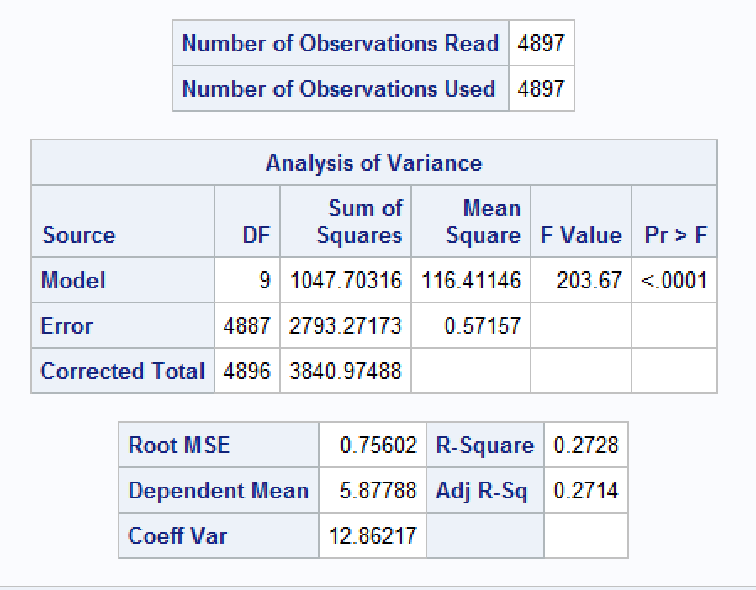
Compare models
New(Remove Density):
Original(Remove #2782):
With lower F value and Adj. R²
Better!
Data Mining II

Slide 15
Result
Estimated Regression Equation:
quality = 211.08254
+ 0.11175 * fixed acidity
- 1.88001 * volatile acidity
+ 0.10140 * residual sugar
+ 0.00351 * free sulfur dioxide
- 211.85542 * density
+ 0.86869 * pH
+ 0.70347 * sulphates
+ 0.11941 * alcohol
Data Mining II

